Slide 1
Graphical User Interface / Swing
Colm Bennett

Slide 2
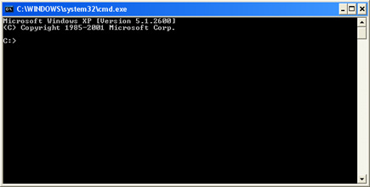
Graphical User Interface (GUI)
Graphical User Interface (GUI)
A type of user interface.
Information and actions are presented to a user through graphical icons.
Allows users to interact with devices using images rather than text commands.
Developed by Xerox (1981).
Apple introduced the menu bar as well as window controls (1983).
There is life after the command prompt,

Slide 3
Java Foundation Classes
The Java Foundation Classes (JFC) are a graphical framework for building portable Java-based graphical user interfaces (GUIs).
JFC consists of:
Swing:
The primary Java GUI widget toolkit.
Written entirely in Java, not implemented by platform-specific code.
Package javax.swing.*, introduced in Java 1.2.
Abstract Window Toolkit (AWT):
Original user interface toolkit.
A wrapper around the native graphical capabilities of the host platform.
Relies on the capabilities of the native widgets, requires developer to be aware of the differences between host platforms.
Avoid using AWT if you can – use Swing instead.
Java 2D:
Application Programming Interface (API) for drawing two-dimensional graphics.

Slide 4
Swing
Portable API:
The appearance and behavior (look-and-feel) of the user interface components are implemented in Java.
Varies with host platform.
Pluggable look-and-feels,
http://docs.oracle.com/javase/tutorial/uiswing/lookandfeel/plaf.html#available
Platform | Look & Feel
Solaris, Linux with GTK+ 2.2 or later | GTK+
Other Solaris, Linux | Motif
IBM UNIX | IBM*
HP UX | HP*
Classic Windows | Windows
Windows XP | Windows XP
Windows Vista | Windows Vista
Macintosh | Macintosh*
Cross-platform (Solaris) | Nimbus+
* Supplied by the system vendor.
+ Nimbus is a cross-platform look and feel introduced in Java SE 6 Update 10

Slide 5
Create a simple GUI
You will remember from last semester we create simple pop up boxes to enter and display details using JOptionPane.
JOptionPane.showInputDialog(null, “some text string”);
JOptionPane.showMessageDialog(null, “some text string”);
To use JOptionPane we had to:
import javax.swing.*;
This is basic GUI development. This semester we are going to develop this and design our own graphical user interfaces.

Slide 6
Create a simple GUI
/*
* MyFirstGUIApp.java
*/
import javax.swing.*;
class MyFirstGUIApp{
public static void main(String args[]){
String name;
name = JOptionPane.showInputDialog(null, "Please enter your name");
JOptionPane.showMessageDialog(null, name +
", welcome to your first Swing GUI ");
}
}

Slide 7
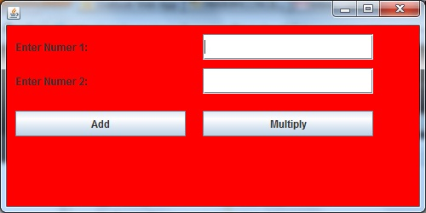
Create our own GUI
Let’s extend this to create our own GUI application
Create a GUI interface that would allow a user to enter two numbers in two separate textboxes.
Include two buttons:
One button to allow a user to ADD the numbers
Second button to allow a user to MULTIPLY the numbers

Slide 8
GUI Class
We first create an instantiable class that extends the Jframe class
This forms our basic structure
JFrame is a swing element, so we need to import the swing class.
/*
* SimpleGUI.java
*/
import javax.swing.*;
class SimpleGUI extends JFrame{
// Rest of code will go here
}

Slide 9
GUI Class
All of the Buttons, Labels, TextFields, Panels, etc are in fact objects.
In Java swings most of these types of object have the letter J prepended – for example a button is called JButton, etc.
We declare them as data members at the top of our class.
JLabel
JTextField
JPanel
JButton

Slide 10
Declaration in GUI Class
We first declare a JPanel to put all of our information into
We then declare 2 JLabel, 2 JTextFields and 2JButtons
//declare objects
private JPanel p;
private JLabel num1JLabel;
private JLabel num2JLabel;
private JTextField num1JTextField;
private JTextField num2JTextField;
private JButton addJButton;
private JButton mulJButton;

Slide 11
Creation in GUI Class
All of the creation of objects is done in the constructor:
public SimpleGUI(){
// creation of objects goes here
}
Before we create individual objects we set the size and location of the JFrame.
public SimpleGUI(){
setSize(500, 250); //set size of JFrame
setLocation(10, 10);//set Location of JFrame on Screen
// rest of creation code follows
}

Slide 12
Creation of JPanel in Constructor
Next we create a JPanel in which to place the buttons.
setLayout – allows set the layout of panel, different layouts are explained later in the slides.
setBackground – allows chose a background colour
add – puts the JPanel on the JFrame
p = new JPanel();//create panel
p.setLayout(null);//set layout of panel
p.setBackground(Color.red);
add(p); //add panel to JFrame
Notes:
Note that a Jframe can actually take components directly, it has a content pane. The reason for using a Jpanel is mainly because it allows us group together components and implies we might add another Jpanel with another group of components at some point. Putting everything into a Jframe is limiting as Jframe is the highest level and we can’t “add” another Jframe with a different group of components.

Slide 13
Creation of JButtons, JLabels, JTextFields
Each of the JLabels, JTextFields, and JButtons are created in a similar manner.
//create objects
num1JLabel = new JLabel("Enter Numer 1:");
num2JLabel = new JLabel("Enter Numer 2:");
num1JTextField = new JTextField();
num2JTextField = new JTextField();
addJButton = new JButton("Add");
mulJButton = new JButton("Multiply");

Slide 14
Set bounds of the JButtons, JLabels, JTextFields
To set the bounds means to give the position (x,y) coordinate on the panel, and to specify the size of the object
The method bounds takes 4 arguments in the following order x, y, width and height.
//set bounds
num1JLabel.setBounds(10, 10, 200, 30); //x, y, width, height
num2JLabel.setBounds(10, 50, 200, 30);
num1JTextField.setBounds(230, 10, 200, 30);
num2JTextField.setBounds(230, 50, 200, 30);
addJButton.setBounds(10, 100, 200, 30);
mulJButton.setBounds(230, 100, 200, 30);

Slide 15
Adds the objects to the JPanel
Finally the objects are all added to the JPanel.
//add objects to panel
p.add(num1JLabel);
p.add(num2JLabel);
p.add(num1JTextField);
p.add(num2JTextField);
p.add(addJButton);
p.add(mulJButton);

Slide 16
NOTE !!!
All of the
creation (use of object constructors),
setLayout, setBackground
setBounds,
add,
is done inside the SimpleGUI instantiable class constructor.

Slide 17
Main Class
Before we can use the GUI we’ve just created we need to declare and create an object for it.
We need to set the visibility to true.
class SimpleGUIApp{
public static void main(String args[]){
SimpleGUI myGUI = new SimpleGUI();
myGUI.setVisible(true);
}
}

Slide 18
Containment Hierarchy
Top-level container are windows:
Place for other Swing components to paint themselves,
JFrame, JDialog, JApplet
Layout containers allow logical grouping for components:
Simplify positioning of components,
JPanel, JSplitPane, JTabbedPane
Container objects group components, arranging them for display with a layout manager.
Components are GUI widgets:
Self-sufficient components that present information to and get input from the user,
JButton, JLabel, JComboBox, JTextField, JTable

Slide 19
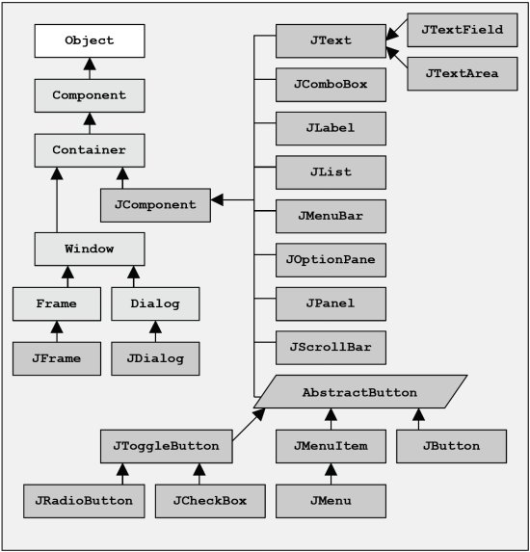
Java Swing Class Hierarchy
A subset of the Swing class hierarchy.
Swing classes - Dark grey.
AWT classes - Light grey.
How Swing components extend the AWT components.
Using Swing in your code,
import java.awt.*; import javax.swing.*;
Notes:
Import AWT for stuff like listeners, shouldn’t actually mix AWT and Swing UI components

Slide 20
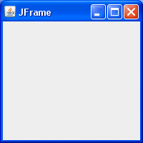
JFrame
A frame is a graphical window that can be used to hold other components.
Creates a frame with an optional title,
public JFrame() or public JFrame(String title)
Puts the given text in the frame’s title bar,
public void setTitle(String text)
Makes the frame perform the given action when it closes,
public void setDefaultCloseOperation(int op)
public void setDefaultCloseOperation(JFrame.EXIT_ON_CLOSE)
Places the given component or container inside the frame.
public void add(Component comp)
How would we add more than one component to the frame?
Resizes the frame to fit the components inside it.
public void pack()
NOTE: Call setVisible(true) to make a frame appear on the screen after creating it.

Slide 21
Positioning Components
Positioning components in the top-level container:
Absolute positioning: Specify exact pixel coordinates for every component.
Layout managers: Automatically position each component based on some criteria.
Return the content pane object for a JFrame,
public Container getContentPane()
Set the layout manager for a JFrame,
public void setLayout(LayoutManager manager)
Layout managers (http://docs.oracle.com/javase/tutorial/uiswing/layout/visual.html):
BorderLayout()
FlowLayout()
GridLayout()
BoxLayout()
CardLayout()
GridBagLayout()
Example:
Container content = frame.getContentPane();
content.setLayout(new FlowLayout());

Slide 22
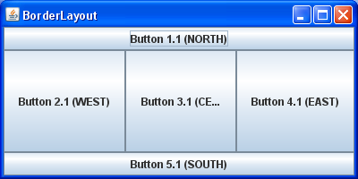
BorderLayout
Divides container into five regions:
NORTH
WEST
CENTER
EAST
SOUTH
NORTH and SOUTH regions expand to fill region horizontally, and use preferred size vertically.
WEST and EAST regions expand to fill region vertically, and use preferred size horizontally.
CENTER uses all space not occupied by others.
Example:
JFrame frame = new JFrame("BorderLayout"); // Instanciate the frame
frame.setMinimumSize(new Dimension(400, 200)); // Set the size of the frame
frame.getContentPane().setLayout(new BorderLayout()); // Use BorderLayout
frame.add(new JButton("Button 1 (NORTH)"), BorderLayout.NORTH); // Add one button in the NORTH position
frame.setVisible(true); // Set the frame to visible

Slide 23
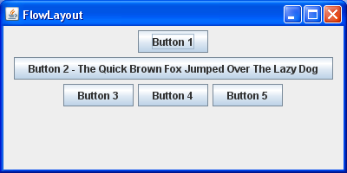
FlowLayout
Container automatically filled left-to-right then top-to-bottom.
Components are given their preferred size both horizontally and vertically.
Components are positioned in order added.
Components will wrap around to next line if too long,
Example:
JFrame frame = new JFrame("FlowLayout "); // Instanciate the frame
frame.setMinimumSize(new Dimension(400, 200)); // Set the size of the frame
frame.getContentPane().setLayout(new FlowLayout()); // Use FlowLayout
frame.add(new JButton("Button 1")); // Add one button
frame.setVisible(true); // Set the frame to visible

Slide 24
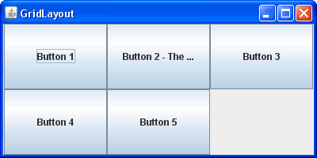
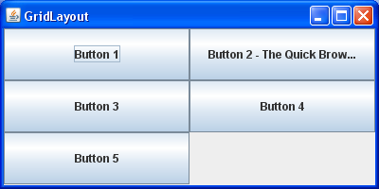
GridLayout
Container acts like a grid of equally-sized rows and columns.
Components are given equal horizontal / vertical size, disregarding preferred size.
public GridLayout(int rows, int columns)
Example:
JFrame frame = new JFrame("GridLayout"); // Instanciate the frame
frame.setMinimumSize(new Dimension(400, 200)); // Set the size of the frame
frame.getContentPane().setLayout(new GridLayout(2,0)); // Use GridLayout with 2 rows. Note zero means as many columns as required
frame.add(new JButton("Button 1")); // Add one button
frame.setVisible(true); // Set the frame to visible
new GridLayout(2,0) // 2 rows
new GridLayout(0,2) // 2 columns
Notes:
Note that the pic for the (2.0) is correct. It looks like it looks at the total number of components to decide no of columns but then fills from top->right down, instead of the zigzag you might expect if the columns were added as needed.

Slide 25
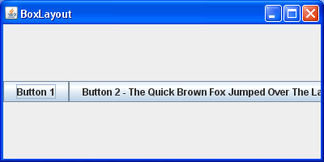
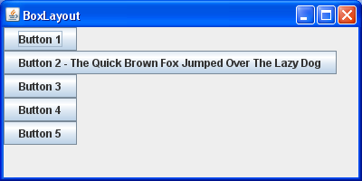
BoxLayout
Aligns components in container in a single row or column
Components use preferred sizes and align based on their preferred alignment
Preferred way to construct a container with box layout:
Example:
JFrame frame = new JFrame("BoxLayout"); // Instanciate the frame
frame.setMinimumSize(new Dimension(400, 200)); // Set the size of the frame
frame.getContentPane().setLayout(new BoxLayout(content, BoxLayout.X_AXIS)); // Use BoxLayout with X_AXIS
frame.add(new JButton("Button 1")); // Add one button
frame.setVisible(true); // Set the frame to visible
new BoxLayout(content, BoxLayout.X_AXIS)
new BoxLayout(content, BoxLayout.Y_AXIS)

Slide 26
Other Layouts
CardLayout:
Treats each component in the container as a card.
Only one card is visible at a time, and the container acts as a stack of cards.
The first component added to a CardLayout object is the visible component when the container is first displayed.
GridBagLayout:
GridBagLayout is one of the most flexible — and complex — layout managers the Java platform provides.
Components placed in a grid of rows and columns.
Specified components to span multiple rows or columns.
Not all rows necessarily have the same height.
Similarly, not all columns necessarily have the same width.
Essentially, GridBagLayout places components in rectangles (cells) in a grid, think HTML table.
Composite Layouts:
Java allows panels within panels to be created.
Each panel has a different layout, and by combining the layouts, more complex / powerful layout can be achieved.

Slide 27
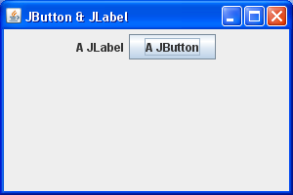
JButton & JLabel
Buttons (JButton) are the most common component
A clickable onscreen region that the user interacts with to perform a single command.
A text label (JLabel) is simply a string of text displayed on screen in a graphical program.
Labels often give information or describe other components.
Creates a new button / label with the given string as its text,
public JButton(String text)
public JLabel(String text)
Returns the text showing on the button / label,
public String getText()
Sets button / label's text to be the given string,
public void setText(String text)

Slide 28
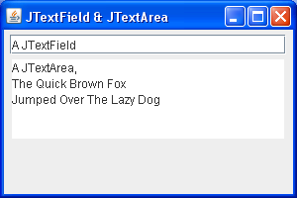
JTextField & JTextArea
JTextField & JTextArea display text and can be edited and modified by the user:
Text field is used for user input, where the user types information in the field and the program reads it,
public JTextField(int columns)
Text area is a multi-line text field. To creates a new text field with a given number of columns (letters) wide,
public JTextArea(int lines, int columns)
JTextField & JTextArea Com,on:
Return the text currently in the field,
public String getText()
Sets field's text to be the given string,
public void setText(String text)
Notes:
Note columns/lines don’t actually limit the amount of info you can enter

Slide 29
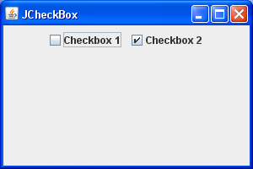
JCheckBox
A check box GUI widget toggles between two states:
Checked; and
Unchecked.
To create a checked/unchecked check box with given text,
public JCheckBox(String text)
public JCheckBox(String text, boolean isChecked)
Returns true if check box is checked,
public boolean isSelected()
Set the check box to be checked/unchecked,
public void setSelected(boolean selected)

Slide 30
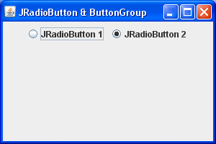
JRadioButton & ButtonGroup
JRadioButton a radio button is a button that can be selected; usually part of a group of two or more mutually-exclusive radio buttons (1 selectable at a time).
To create a checked/unchecked radio button with given text,
public JRadioButton(String text)
public JRadioButton(String text, boolean isChecked)
Returns true if check box is checked,
public boolean isSelected()
Set the check box to be checked/unchecked,
public void setSelected(boolean selected)
ButtonGroup (note no “J” prefix) is a logical group of radio buttons that ensures that only one is selected at a time,
public ButtonGroup()
public void add(JRadioButton button)

Slide 31
Swing Documentation & Examples
Oracle Java SE 7 Documentation
http://docs.oracle.com/javase/7/docs/api/index.html
Oracle How to use Swing
http://docs.oracle.com/javase/tutorial/uiswing/components
Designing a Swing GUI in NetBeans IDE
http://netbeans.org/kb/docs/java/quickstart-gui.html
Creating a GUI With JFC/Swing
http://docs.oracle.com/javase/tutorial/uiswing
Using Swing Components
http://docs.oracle.com/javase/tutorial/uiswing/examples/components/index.html

Slide 32
Worked Example
Although the example in the notes was written by hand, Netbeans allows us to do most of this by dragging and dropping.

Slide 33
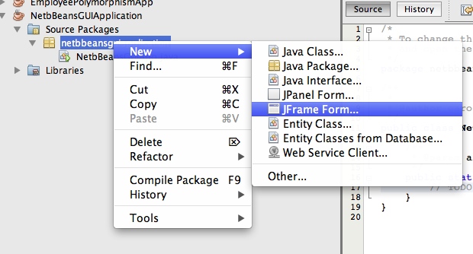
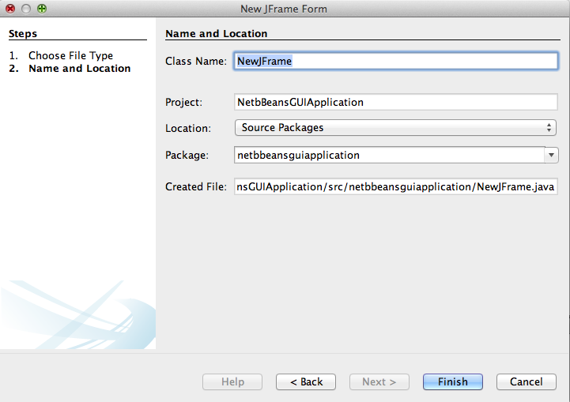
Step 2 – Create a New JFrame Form
Step 1 – Create a New Project

Slide 34
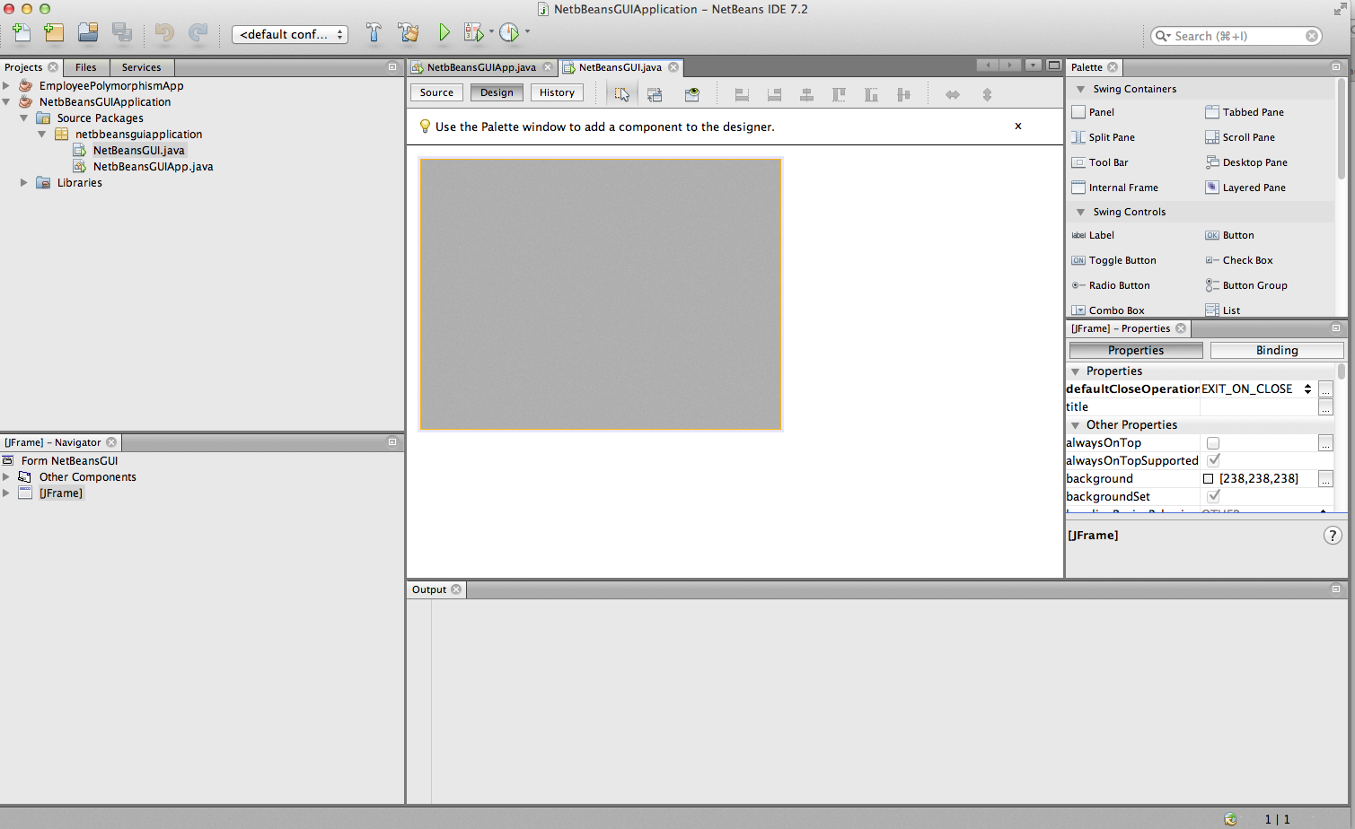
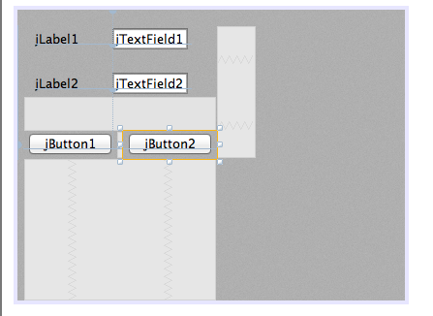
Step 3 – Using palette on RHS, we drag and drop the JPanel, JButtons, etc

Slide 35
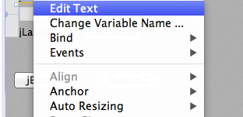
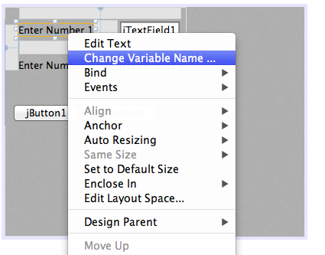
Step 4 – Right click on each object to change edit the text.
Step 5 – Right click on each object to change the variable name.

Slide 36
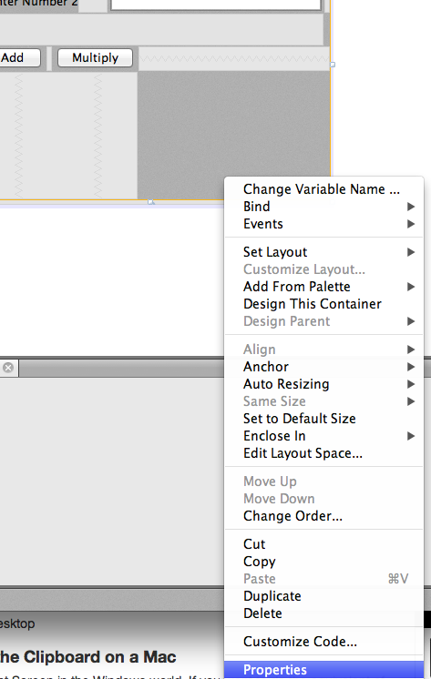
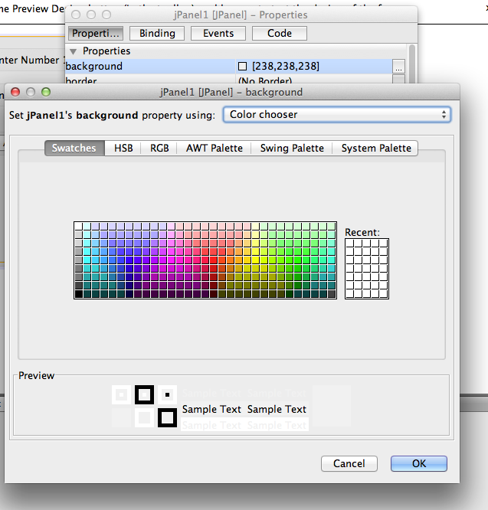
Step 6 – To change background colour, right click on JPanel and go to Properties

Slide 37
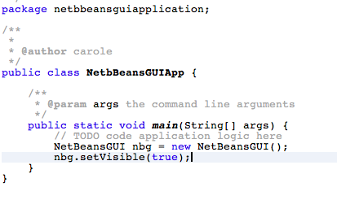
Step 7 – Edit the Main Class to declare and create object and set visibility to true

